Slide 1
WELCOME
Session 4
What makes someone a Christian ?

Slide 2
What is a Christian?
Mark 1:15
“The time has come”, he said. “The kingdom of God is near. Repent and believe the good news!”
- Jesus

Slide 3
What is so good about
being a Christian?
(What does a Christian Receive?)

Slide 4
1. We are made
right with God
“Therefore, since we have been justified through faith, we have peace with God through our Lord Jesus Christ.”
Romans 5:1

Slide 5
2. We receive the
forgiveness of sin
3. We receive
The Holy Spirit
'Peter replied, “Repent and be baptised, every one of you, in the name of Jesus Christ for the forgiveness of your sins. And you will receive the gift of the Holy Spirit.”
Acts 2:38

Slide 6
4. We become a
new creation by
God’s working
“Therefore, if anyone is in Christ, he is a new creation; the old has gone, the new has come!”
2 Corinthians 5:17

Slide 7
5. We are made
God’s children
“In love God predestined us to be adopted as his sons through Jesus Christ.”
Ephesians 1:5

Slide 8
6. The promise
to be perfected and
to enjoy eternal life
“When this corruptible body is clothed with incorruptibility, and this mortal body is clothed with immortality, then the saying that is written will take place: Death has been swallowed up in victory.”
1 Corinthians 15:54
“For God so loved the world that he gave his one and only Son, that whoever believes in him shall not perish but have eternal life.”
John 3:16

Slide 9

WHAT MAKES SOMEONE
A CHRISTIAN ?

Slide 10
What makes someone a Christian?
We must
REPENT
“Repent then, and turn to God, so that your sins may be wiped out, that times of refreshing may come from the Lord.”
Acts 3:19

Slide 11

WHAT REPENTANCE
ISN’T

Slide 12
WHAT REPENTANCE IS
1. Recognition you are going the WRONG WAY

Slide 13
WHAT REPENTANCE IS
2. A change of Mind
“I know my transgressions (breaking of God’s law), and my sin is always before me. Against you, you only have I sinned and done what is evil in your sight, so that you are proved right when you speak and justified when you judge.”
Psalm 51:4

Slide 14


Slide 15
WHAT REPENTANCE IS
3. A change in our Emotions
“The sacrifices of God are a broken spirit; a broken and contrite heart, O God, you will not despise.”
Psalm 51:17
“Rend your heart and not your garments. Return to the LORD your God…”
Joel 2:13

Slide 16
WHAT REPENTANCE IS
“Have mercy on me O God, according to your unfailing love; according to your great compassion blot out my transgressions. Wash away my iniquity and cleanse me from my sin.”
Psalm 51:1-2
4. Causes us to plead
for God’s Forgiveness
“Rend your heart and not your garments. Return to the LORD your God, for he is gracious and compassionate...”
Joel 2:13

Slide 17
WHAT REPENTANCE IS
5. Willingness to part with sin
“They tell how you turned to God from idols to serve the living and true God.”
1 Thessalonians 1:9b

Slide 18
WHAT REPENTANCE IS
6. A gift from God
“…So then, God has granted even the Gentiles (non-Jewish people) repentance unto life.”
Acts 11:18

Slide 19

“We must go through many hardships to enter
the kingdom of God.” Acts 14:22
“...Any of you who does not give up everything he has cannot be my disciple.”
Luke 14:33

Slide 20
What makes someone a Christian?
1. We must
REPENT
2. We must
Believe (have faith) in Jesus

Slide 21
WHAT IS F A I T H ?
1. Accepting what the Bible says about Jesus
Jesus replied, “That is why I said you will die in your sins; for unless you believe that I Am who I claim to be, you will die in your sins.”
John 8:24

Slide 22
WHAT IS F A I T H ?
2. To trust in and
rely on Jesus
“But blessed is the man who trusts in the LORD, whose confidence is in Him.”
Jeremiah 17:7

Slide 23
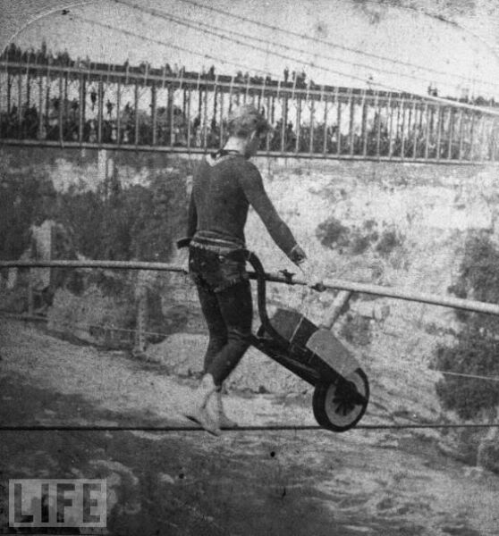

Slide 24
WHAT IS F A I T H ?
3. Faith isn’t
measured by its size
The father of the demon-possessed child said to Jesus, “But if you can do anything, take pity on us and help us.”
“If you can?” said Jesus. “Everything is possible for him who believes.” Immediately the boy’s father exclaimed, “I do believe; help me overcome my unbelief!”
Mark 9:22b-24

Slide 25
WHAT IS F A I T H ?
4. It’s about what
your faith is in
“The LORD is my rock, my fortress, and my deliverer; my God is my rock, in whom I take refuge. He is my shield, the horn (power) of my salvation, my stronghold.”
Psalm 18:2

Slide 26


Slide 27
WHAT IS F A I T H ?
5. Faith rests upon God’s Word
not our feelings
“Yet to all who received him, to those who believed in his name, he gave the right to become children of God.”
John 1:12

Slide 28
WHAT IS F A I T H ?
6. Faith ALONE saves
not our works
“If you confess with your mouth, "Jesus is Lord," and believe in your heart that God raised him from the dead, you will be saved.”
Romans 10:9
“Believe in the Lord Jesus and you will be saved…”
Acts 16:31

Slide 29

HOW DOES A PERSON
GAIN FAITH ?
“Consequently, faith comes from hearing the message, and the message is heard through the word of Christ.”
Romans 10:17
1. Faith comes by Hearing the Message

Slide 30
HOW DOES A PERSON
GAIN FAITH ?
“For it is by grace you have been saved, through faith – and this is not from yourselves, it is the gift of God – not by works, so that no one can boast.”
Ephesians 2:8-9
2. Faith is a
Gift from God
‘Jesus looked at them and said, ”With man this is impossible, but not with God; all things are possible with God.”
Mark 10:27

Slide 31
If You want to be saved,
what should you do?
Remove these Obstacles!
1. Don’t wait PASSIVELY
For God to give you faith
“You will seek me and find me when you seek me with all your heart.”
Jeremiah 29:13
“Seek the LORD while he may be found; call on him while he is near.”
Isaiah 55:6-7

Slide 32

“If you want to believe in Jesus –
hear about Him, read about Him, think about Him, know about Him, and so you will find faith springing up in your heart…”
- Charles Spurgeon

Slide 33
If You want faith
what should you do?
Remove these Obstacles!
2. Be Willing and Resolved to part with Treasured sins

Slide 34
HOW WILL
YOU RESPOND ?
“Whoever believes in the Son has eternal life, but whoever rejects the Son will not see life, for God’s wrath remains on him.”
John 3:36

Slide 35
Feel free to discuss the following questions or ask any that you may have…
Based on what you have learnt in this course,
where would you go if you died today?
2. What does repentance involve?
3. What is faith and how does someone obtain it?
4. What is the cost to becoming a Christian? Why is
becoming a Christian worth it?

