Slide 1
WELCOME
Session 2
What did Jesus come to do ?

Slide 2
Jesus came
to Die

Slide 3
Mark 10:45
“For even the Son of Man did not come to be served, but to serve, and give to his life as a ransom for many.”

Slide 4
SIGNIFICANT TRUTHS ABOUT
JESUS’ DEATH
7

Slide 5
“He was assigned a grave with the wicked.”
Isaiah 53:9
“…His appearance was so disfigured beyond that of any man, and his form marred beyond human likeness.”
Isaiah 52:14
1. Jesus died by crucifixion to
Fulfil Old Testament prophecy

Slide 6
“For even the Son of Man did not come to be served, but to serve, and to give his life as a ransom for many.”
Mark 10:45
“For the wages of sin is death…”
Romans 6:23
2. Jesus’ death was a payment

Slide 7
“But he was pierced for our transgressions, he was crushed for our iniquities; the punishment that brought us peace was upon him, and by his wounds we are healed. We all, like sheep, have gone astray, each of us has turned to his own way; and the LORD has laid on him the iniquity of us all.”
Isaiah 53:5-6
3. Jesus died to take our sin upon Himself

Slide 8
“He himself bore our sins in his body on the tree (cross)...”
1 Peter 2:24
“For Christ died for sins once for all, the righteous for the unrighteous, that he might bring us to God.”
1 Peter 3:18

Slide 9
“Since we have now been justified (made right) by his blood, how much more shall we be saved from God’s wrath through him!”
Romans 5:9
4. Jesus died to satisfy God’s holy anger against us

Slide 10
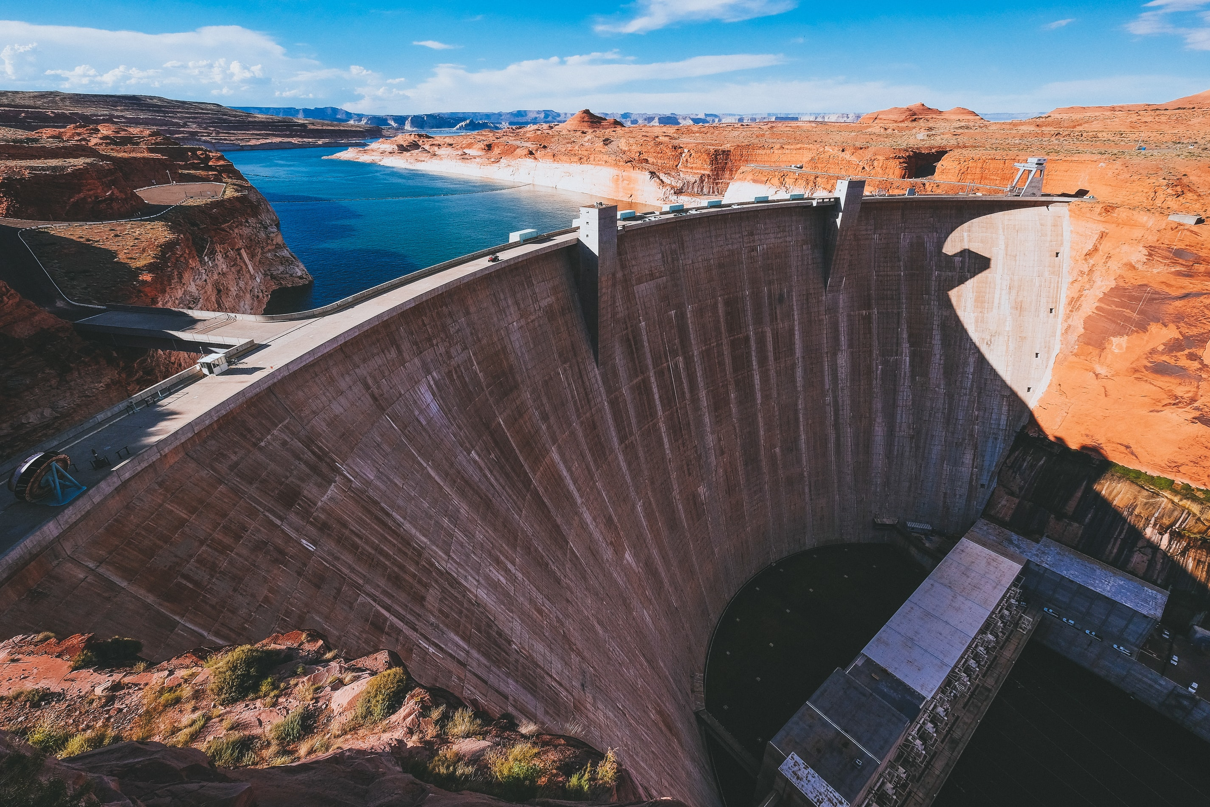

Slide 11
“God made him [Jesus] who had no sin to be sin for us, so that in him we might become the righteousness of God.”
2 Corinthians 5:21
5. Jesus died to give us what we desperately needed

Slide 12
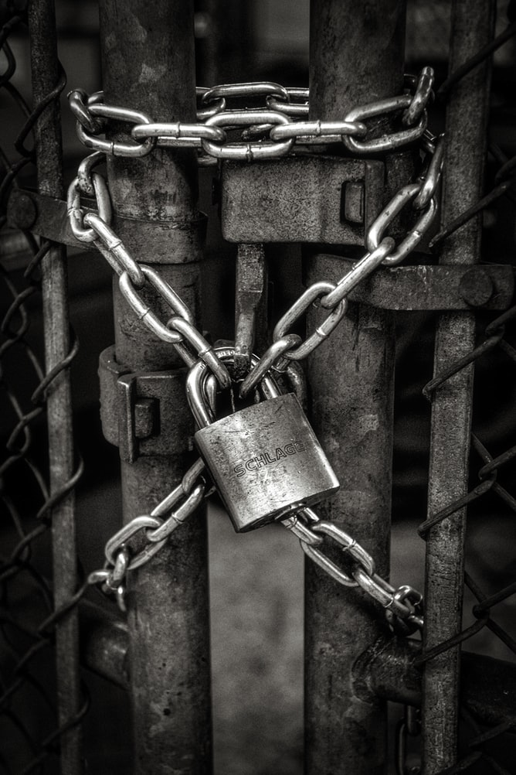
6. Jesus died to restore us to God

Slide 13
“This includes you who were once far away from God. You were his enemies, separated from him by your evil thoughts and actions. Yet now he has reconciled you to himself through the death of Christ in his physical body. As a result, he has brought you into his own presence, and you are holy and blameless as you stand before him without a single fault.”
Colossians 1:21-22 (NLT)
“Remember...you were separate from Christ... without hope and without God in the world.”
Ephesians 2:12
“For Christ died for since once for all, the righteous for the unrighteous, to bring you to God.”
1 Peter 3:18

Slide 14
“For God so loved the world that He gave His one and only Son, that whoever believes in Him shall not perish, but have eternal life.”
John 3:16
7. Jesus died to bring forgiveness & eternal life (salvation)

Slide 15

Mark 2:17
“It is not the healthy who need a doctor, but the sick. I have not come to call the righteous, but sinners.”

Slide 16
INTERMISSION

Slide 17
How could One Man’s Death
accomplish so much?
Because of the
Life He Lived

Slide 18
Jesus Lived the Life God required of Us

Slide 19
Jesus Lived the Life God required of Us
1. Jesus lived a
Sinless Life
“Such a high priest truly meets our need; one who is holy, blameless, pure, set apart from sinners, exalted above the heavens.”
Hebrews 7:26
“But you know that he appeared so that he might take away our sins. And in him is no sin.”
1 John 3:5

Slide 20
Jesus Lived the Life God required of Us
2. Jesus lived a
Righteous Life
“Do not think that I have come to abolish the Law and the prophets; I have not come to abolish them but to fulfil them.”
Matthew 5:17

Slide 21
WE SIN IN
DIFFERENT WAYS:
2
1. We do what we shouldn’t do
2. We don’t do what we should do

Slide 22
Jesus came to
Rise Again and Secure
Our Resurrection
Read:
Mark 16:1-8

Slide 23
How could we possibly believe in the Resurrection?
1. Jesus appeared
first to women

Slide 24
2. Jesus appeared to
the disciples
3. Jesus appeared to 500 people
at once
4. Jesus’ body has never been found
5. Jesus’ resurrection changed people’s lives

Slide 25
The Significance of
Jesus’ Resurrection
1. Jesus rose again to Conquer sin and death
Read :
Mark 10:32-34

Slide 26
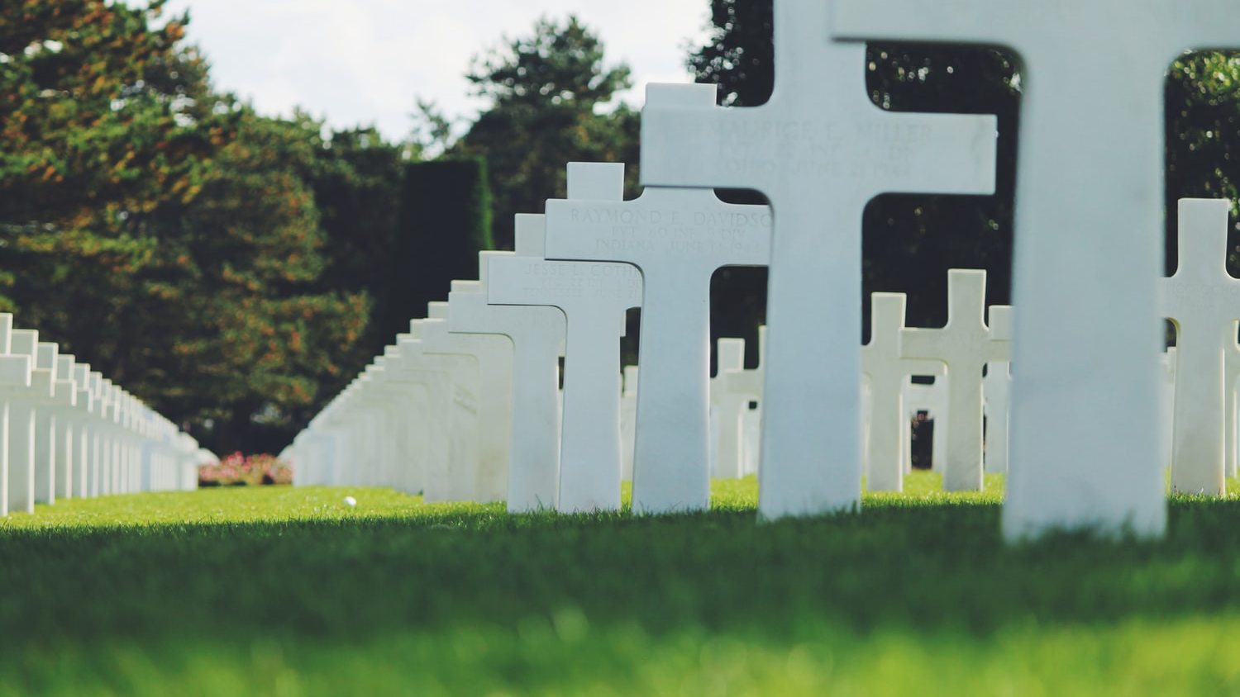
“For we know that since Christ was raised from the dead, he cannot die again; death no longer has mastery over him.”
Romans 6:9
“Where, O death, is your victory? Where, O death, is your sting? The sting of death is sin, and the power of sin is the law. But thanks be to God! He gives us the victory through our Lord Jesus Christ.” 1 Corinthians 15:55-57

Slide 27
The Significance of
Jesus’ Resurrection
2. Jesus’ resurrection proves his sacrifice was accepted by God
“He was delivered over to death for our sins and was raised to life for our justification.”
Romans 4:25

Slide 28
The Significance of
Jesus’ Resurrection
3. Jesus rose again to
return as judge
“In the past God overlooked such ignorance, but now he commands all people everywhere to repent. For He has set a day when He will judge the world with justice by the man He has appointed. He has given proof of this to all men by raising him from the dead.” Acts 17:30-31

Slide 29
Hebrews 9:28
“So Christ was sacrificed once to take away the sins of many; and he will appear a second time, not to bear sin, but to bring salvation to those who are waiting for him.”

Slide 30
The Significance of
Jesus’ Resurrection
4. Jesus’ resurrection ensures the future resurrection of all people
“Because we know that the one who raised the Lord Jesus from the dead will also raise us with Jesus…”
2 Corinthians 4:14
“Do not be amazed at this, for a time is coming when all who are in their graves will hear his voice and come out - those who have done what is good will rise to live, and those who have done what is evil will rise to be condemned.”
John 5:28-29

Slide 31



Slide 32
SEE YOU
NEXT TIME FOR
Session 3
Why is Jesus needed ?
Read this Week:
Mark 7-11

Slide 33
Feel free to Discuss the following questions or ask any you may have…
1. How would you sum up the purpose of Jesus’ first coming?
2. Why did Jesus have to ‘die’?
3. Why is it so important that Jesus rose from the dead?
4. What does Jesus’ resurrection guarantee for the future?
5. As you consider how greatly Jesus had to suffer,
what does this tell you about our condition?

